Slide 1

Coaching Course
教练员培训课程 Breathing
呼吸
Pascal Colmaire – WA Development & Education Director
Notes:
当我们谈到“呼吸”时，我们的意思是发生在人类呼吸的潜意识中的有规律的循环活动的偏差。这些“呼吸”也在潜意识中发生，但它们可以被训练用于特殊活动，如射箭。
When we speak about ‘breathing’ we mean the deviation that takes place in the subconscious, regular cyclic activity of human breathing. These ‘breathings’ take also place subconscious, but they can be trained for special activities, such as in archery.

Slide 2
BREATHING 呼吸
Benefits in archery 射箭运动的益处
Concentration 专注
Help to be “here & now” on the task at hand
有助于专注正在进行的任务
Attention 注意
Facilitate the internal mode 便于内部模式
Relaxation 放松
Regulate the internal stress 调节内部压力
Rhythm 节奏
Pace the action 加快动作速度
Reminder / Score / Checklist 提醒 / 标记/ 备忘录
Help to respect all the sequence steps 有助于遵守所有顺序步骤
Physiology 生理
In respect of effort production and accurate task / search of stability 运动成绩和任务完成精确度的稳定性
Pascal Colmaire – WA Development & Education Director
Notes:
Quite self explanatory
Reminder / Score / Checklist: due to the association between the breath and the different steps of the sequence, the shots are always executed according to the same pattern
Physiology : The breathing sequence must be built in respect of the physiological rules of efforts production and also to provide as much stability as possible while aiming.

Slide 3
BREATHING 呼吸
Sequence 顺序
Goal = to provide the previous benefits
目标 = 为了获得之前提到的益处
Several breathing sequences are used, pending:
使用了几个呼吸顺序，如：
The sequence of motions (the technique)
运动的顺序（技术动作）
The archer’s:- 射箭运动员的：
Biorhythm / mindset of the day 当天的生物节律/心态
Physical condition (tired…) 身体状况（疲惫等）
Mental state (stressed…) 心理状态（紧张等）
… 等等
Pascal Colmaire – WA Development & Education Director
Notes:
Also quite self explanatory
The stress can modify the shooting sequence with the introduction of sighs, longer exhales…

Slide 4
BREATHING 呼吸
Sequence identification 确定顺序
Difficulty
Not easy to listen our breath without modification.
难点
不经改变很难听到我们的呼吸
Process
Identify the motion sequence first then write below each associated breath motion.
过程
首先确定运动顺序，然后记录每个相关的呼吸运动.
Pascal Colmaire – WA Development & Education Director
Notes:
当弓箭手试图辨认他们的呼吸模式时，他们经常受到干扰。但一旦确定，他们将获得幻灯片2中列出的所有好处。
一旦识别出1（只有一个）呼吸动作——例如，我在锚定前呼气一点（然后屏住呼吸）——就可以很好地开始识别其余的呼吸顺序，因为，你只需要：
识别之前的呼吸动作，根据这个例子，它可能是一次吸气，然后是之前的呼吸动作（可能是一次呼气），以及之前的呼吸动作（可能是一次吸气），等等……
识别下一个呼吸动作，根据这个例子，它可能是呼气，然后是之前的呼吸动作（可能是吸气），以及之前的呼吸动作（可能是呼气），等等……
Archers are very often disturbed when they try to identify their breathing pattern. But once identified they get all the benefits listed on slide #2
Once 1 (only one) breathing motion is identified - for instance I exhale a little beat before anchoring (then hold my breath) – it is a good start to identify the rest of the breathing sequence because, you just have to:
Identify the previous breathing motion, according to this example it is probably an inhale, then the breathing motion again before (probably an exhale), and the one again before (probably an inhale) and so on….
Identify the next breathing motion, according to this example it is probably an exhale, then the breathing motion again before (probably an inhale), and the one again before (probably an exhale) and so on….

Slide 5

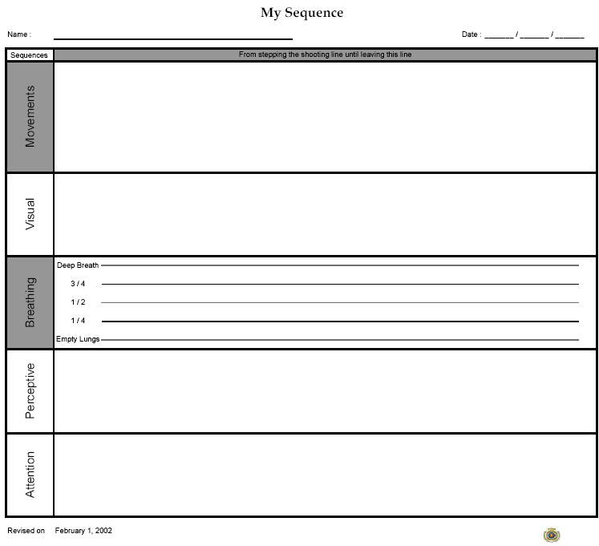
Shooting Sequence Steps射箭动作步骤
Pascal Colmaire – Development & Education Director of WA
Notes:
当弓箭手试图辨认他们的呼吸模式时，他们经常受到干扰。但一旦确定，他们将获得幻灯片2中列出的所有好处。
一旦识别出1（只有一个）呼吸动作——例如，我在锚定前呼气一点（然后屏住呼吸）——就可以很好地开始识别其余的呼吸顺序，因为，你只需要：
识别之前的呼吸动作，根据这个例子，它可能是一次吸气，然后是之前的呼吸动作（可能是一次呼气），以及之前的呼吸动作（可能是一次吸气），等等……
识别下一个呼吸动作，根据这个例子，它可能是呼气，然后是之前的呼吸动作（可能是吸气），以及之前的呼吸动作（可能是呼气），等等……
Such a sequence must be built for each archer, since there is not a universal one. Hence the coach should assist the archer to identify and memorize the script of his/her sequence. In fact, we can write down the script of various sequences:
of the movements (the physical one), on the example of record form above, it is suggested to write each movement vertically in order to list under each one what is watching, what is the breathing pattern (inhale, hold or exhale)...
of the visual – just write down vertically, under each motion, what the archer look at
Breathing - on the example of record form above it is suggested to simply draw a line:
Up when inhaling
Horizontal when holding the breath
Down when exhaling
The boxes to record the perceptions and the attention type are for advanced archers.
It is interesting for the archer to summarize in detail what the steps of their shooting sequence in detail include.

Slide 6
BREATHING 呼吸
Human habits 人们的习惯
Breathing and beginning an action 呼吸和开始运动
Breathing and meticulous execution of an action
呼吸和认真地完成一个动作
Breathing and end of an action 呼吸和结束运动
Example of passing a thread through the eye of a needle 举例：穿针
Pascal Colmaire – WA Development & Education Director
Notes:
这个例子（白色）应该有助于理解黄色的三个习惯。将线穿入针眼的常见过程包括：
在开始时呼吸（吸气），即一起移动手臂=呼吸并开始动作
屏住呼吸，同时努力将线穿过针孔=呼吸和动作的细致执行
当线穿过时呼气=呼吸和动作结束
正如在接下来的幻灯片中所解释的，这三个习惯在拍摄顺序的大部分步骤中都有。
The example (in white) should help to understand the three habits in yellow. The common process to pass a thread into the eye of a needle includes:
Take a breath (inhale) at the start, i.e. moving arms together = Breathing and beginning an action
Hold the breath while striving to put the thread through the needle hole = Breathing and meticulous execution of an action
Exhale when the thread is passed through = Breathing and end of an action
As explained over the next slides, these 3 habits are found in most of the steps of the shooting sequence

Slide 7
BREATHING 呼吸
Sequence examples 呼吸顺序的举例
Breathing and beginning an action 呼吸和开始运动
Inhale then advance to the shooting line;
吸气，然后进入起射线
Inhale then take an arrow out of the quiver;
吸气；然后从箭袋中取出箭
Inhale then grip the string; 吸气；然后预拉
Inhale then lift the bow to the target; 吸气；然后瞄准
Pascal Colmaire – WA Development & Education Director
Notes:
Self explanatory

Slide 8
BREATHING 呼吸
Sequence examples 呼吸顺序的举例
Breathing and meticulous execution of an action.
呼吸和认真地完成一个动作
Hold the breath while placing the feet either side of the shooting line 将两脚分别放在射击线两侧时，屏住呼吸
Hold the breath while loading the arrow on the bow (string and arrow-rest); 搭箭时，屏住呼吸
Hold the breath while placing the string fingers and the bow-hand; 放置钩弦指和持弓手时，屏住呼吸
Hold the breath while pre-setting (pre-draw);
预拉时，屏住呼吸；
Hold the breath while aiming 瞄准时，屏住呼吸
Pascal Colmaire – WA Development & Education Director
Notes:
Self explanatory

Slide 9
BREATHING 呼吸
Sequence examples 呼吸顺序的距离
Breathing and end of action 呼吸和动作结束
Exhale toward the end of placing the feet either side
将两脚放在起射线的动作结束时呼气；
Exhale toward the end of the arrow loading;
搭箭结束时呼气；
Exhale toward the end of the string fingers and the bow-hand positioning;
钩弦指和持弓手定位结束时呼气；
• Exhale slightly toward the end of the draw / face marks action. 脱弦结束时慢慢呼气./面部标志动作
Pascal Colmaire – WA Development & Education Director
Notes:
Self explanatory

Slide 10
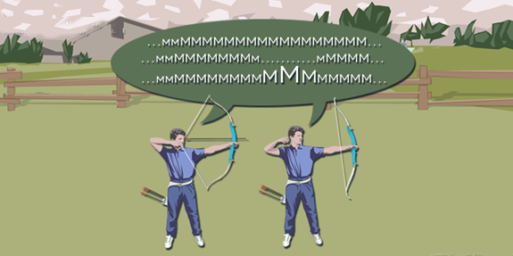
BREATHING 呼吸
Breathing rules 呼吸规律
For the main action: full draw, extension, aiming…
A reserve of air in the lungs is necessary, but the lungs should not be filled up.
主要运动环节：开满弓、继续用力、瞄准…
肺部留有空气是必要的，但不应被填满.
Hold, not blocked
During the main action hold your breath with unlocked breathing pipe.
保持，但不憋气
在主要动作环节中，屏住呼吸但保持呼吸道顺畅.
Breathing during the follow-through
Keep the same breathing motion while releasing
动作暂留时保持呼吸
撒放时保持相同的呼吸运动
Pascal Colmaire – WA Development & Education Director
Notes:
The illustration is related to the last (3rd) rule. This exercise is also introduced in the Continuity/Follow-through set of slides. Your student must emit a throat sound, like “MMmmmmmmm…”
Start the sound with aiming, strive to keep the same volume and note all way through the end of the shot – See line #1 of the speech bubble
There should be no break as in line #2 of the speech bubble – Probably the archer does not stop the breath only, but also some other activities (mental, physical…)
Also there should not be any intensity increase as in line #3 of the speech bubble – Probably the release is too much provoked

Slide 11
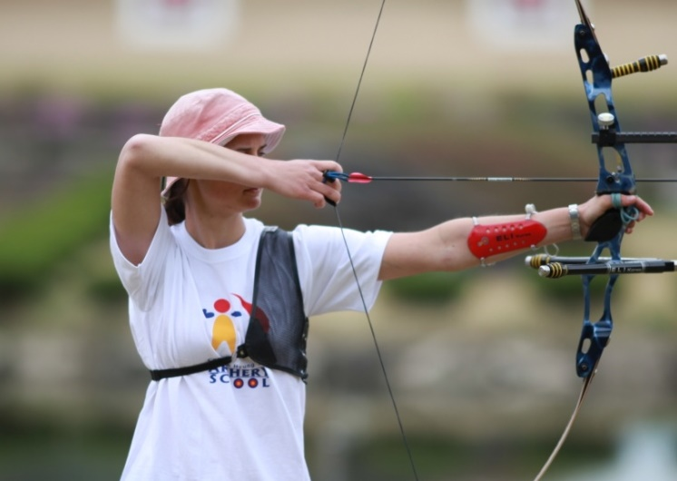
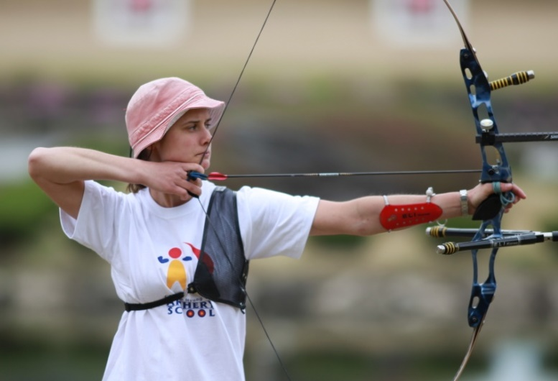

Breathing 呼吸
Period of production of the efforts力的产生阶段
Breath in
吸气
Partial breath out, then hold the breath
呼出部分气体，
然后保持呼吸
Pascal Colmaire – World Archery Development & Education Director
Notes:
有一套专门用于呼吸的幻灯片。
由每个教练决定何时教授呼吸。它可以包括对每种射击技能的训练，也可以包括在动作序列上设置呼吸序列（一旦设置了最新的动作序列）。
There is a set of slides dedicated to breathing.
It is up to each coach to decide when to teach the breathing. It could be including to the training of each shooting skill, or it could consist to put a breathing sequence upon the sequence of movements (once this latest is set).

Slide 12

Thank you… 谢谢 Ready to answer your questions! 请你们自由提问！
Pascal Colmaire – WA Development & Education Director

